Slide 1

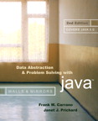
Chapter 7
Stacks

Slide 2
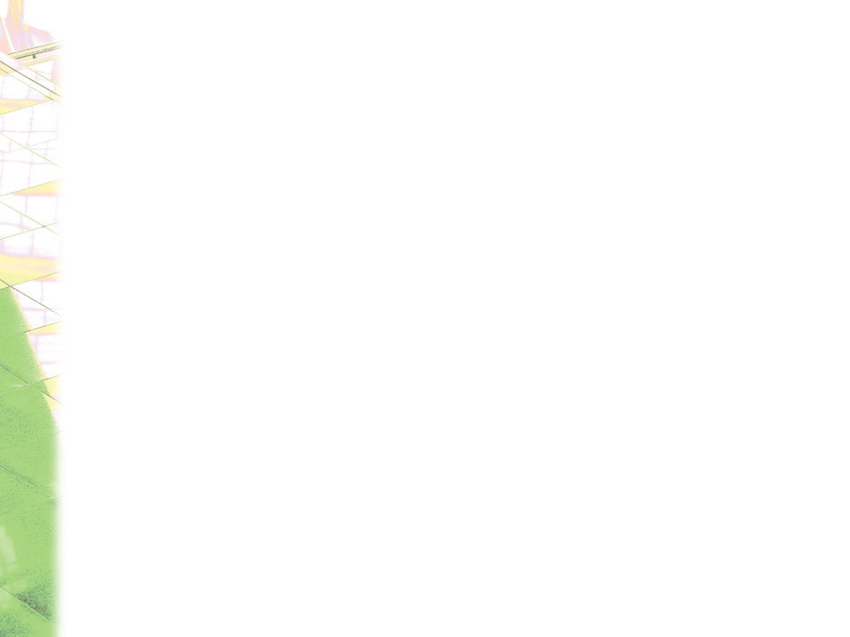
The Abstract Data Type:
Developing an ADT During the Design of a Solution
Specifications of an abstract data type for a particular problem
  Can emerge during the design of the problem’s solution
  Examples
    readAndCorrect algorithm
    displayBackward algorithm

Slide 3
Developing an ADT During the Design of a Solution
ADT stack operations
  Create an empty stack
  Determine whether a stack is empty
  Add a new item to the stack
  Remove from the stack the item that was added most recently
  Remove all the items from the stack
  Retrieve from the stack the item that was added most recently

Slide 4
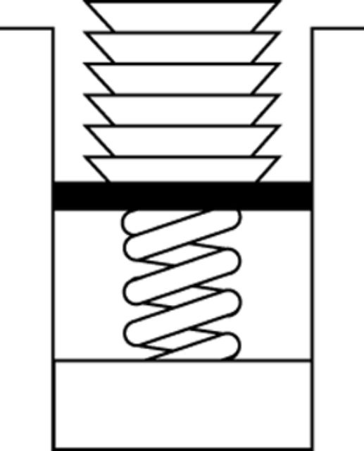
Developing an ADT During the Design of a Solution
A stack
  Last-in, first-out (LIFO) property
    The last item placed on the stack will be the first item removed
  Analogy
    A stack of dishes in a cafeteria
Figure 7-1
Stack of cafeteria dishes

Slide 5
Developing an ADT During the Design of a Solution
A queue
  First in, first out (FIFO) property
    The first item added is the first item to be removed

Slide 6
Refining the Definition of the ADT Stack
Pseudocode for the ADT stack operations
  createStack()
  // Creates an empty stack.
  isEmpty()
  // Determines whether a stack is empty.
  push(newItem) throws StackException
  // Adds newItem to the top of the stack.
  // Throws StackException if the insertion is
  // not successful.

Slide 7
Refining the Definition of the ADT Stack
Pseudocode for the ADT stack operations (Continued)
  pop() throws StackException
  // Retrieves and then removes the top of the stack.
  // Throws StackException if the deletion is not
  // successful.
  popAll()
  // Removes all items from the stack.
  peek() throws StackException
  // Retrieves the top of the stack. Throws
  // StackException if the retrieval is not successful

Slide 8
Using the ADT Stack in a Solution
displayBackward and readAndCorrect algorithms can be refined by using stack operations
A program can use a stack independently of the stack’s implementation

Slide 9
Axioms (Optional)
Axioms are used to define an ADT formally
  Example
    Axiom to specify that the last item inserted into stack is the first item to be removed
      (stack.push(newItem)).pop() = stack

Slide 10
Simple Applications of the ADT Stack: Checking for Balanced Braces
A stack can be used to verify whether a program contains balanced braces
  An example of balanced braces
    abc{defg{ijk}{l{mn}}op}qr
  An example of unbalanced braces
    abc{def}}{ghij{kl}m

Slide 11
Checking for Balanced Braces
Requirements for balanced braces
  Each time you encounter a “}”, it matches an already encountered “{”
  When you reach the end of the string, you have matched each “{”

Slide 12
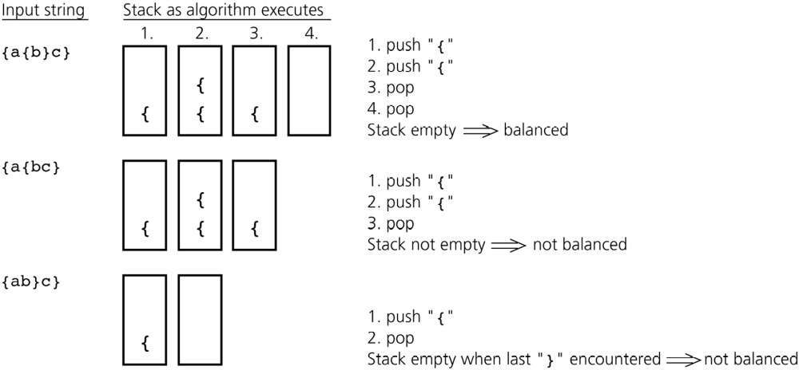
Checking for Balanced Braces
Figure 7-3
Traces of the algorithm that checks for balanced braces

Slide 13
Checking for Balanced Braces
The exception StackException
  A Java method that implements the balanced-braces algorithm should do one of the following
    Take precautions to avoid an exception
    Provide try and catch blocks to handle a possible exception

Slide 14
Recognizing Strings in a Language
Language L
  L = {w$w’ : w is a possible empty string of characters other than $,
    w’ = reverse(w) }
  A stack can be used to determine whether a given string is in L
    Traverse the first half of the string, pushing each character onto a stack
    Once you reach the $, for each character in the second half of the string, pop a character off the stack
      Match the popped character with the current character in the string

Slide 15
Implementations of the ADT Stack
The ADT stack can be implemented using
  An array
  A linked list
  The ADT list
StackInterface
  Provides a common specification for the three implementations
StackException
  Used by StackInterface
  Extends java.lang.RuntimeException

Slide 16
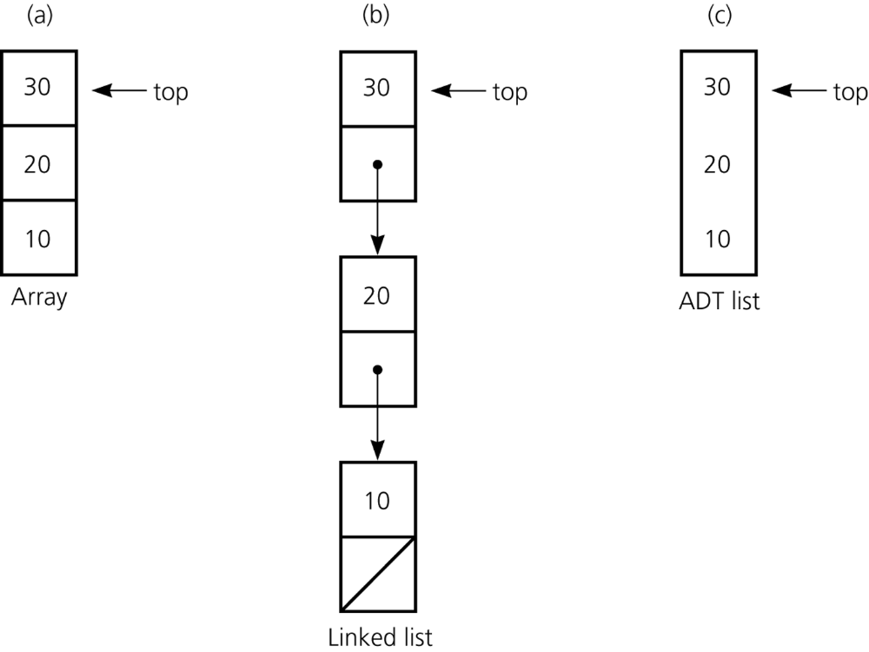
Implementations of the ADT Stack
Figure 7-4
Implementation of the ADT stack that use a) an array; b) a linked list;
c) an ADT list

Slide 17
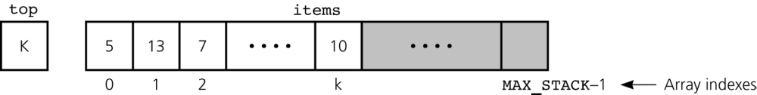
An Array-Based Implementation of the ADT Stack
StackArrayBased class
  Implements StackInterface
  Instances
    Stacks
  Private data fields
    An array of Objects called items
    The index top
Figure 7-5
An array-based implementation

Slide 18
A Reference-Based Implementation of the ADT Stack
A reference-based implementation
  Required when the stack needs to grow and shrink dynamically
StackReferenceBased
  Implements StackInterface
  top is a reference to the head of a linked list of items

Slide 19
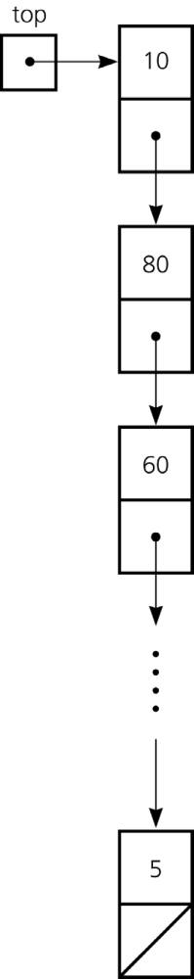
A Reference-Based Implementation of the ADT Stack
Figure 7-6
A reference-based
implementation

Slide 20
An Implementation That Uses the ADT List
The ADT list can be used to represent the items in a stack
If the item in position 1 of a list represents the top of the stack
  push(newItem) operation is implemented as
    add(1, newItem)
  pop() operation is implemented as
    get(1)
    remove(1)
  peek() operation is implemented as
    get(1)

Slide 21
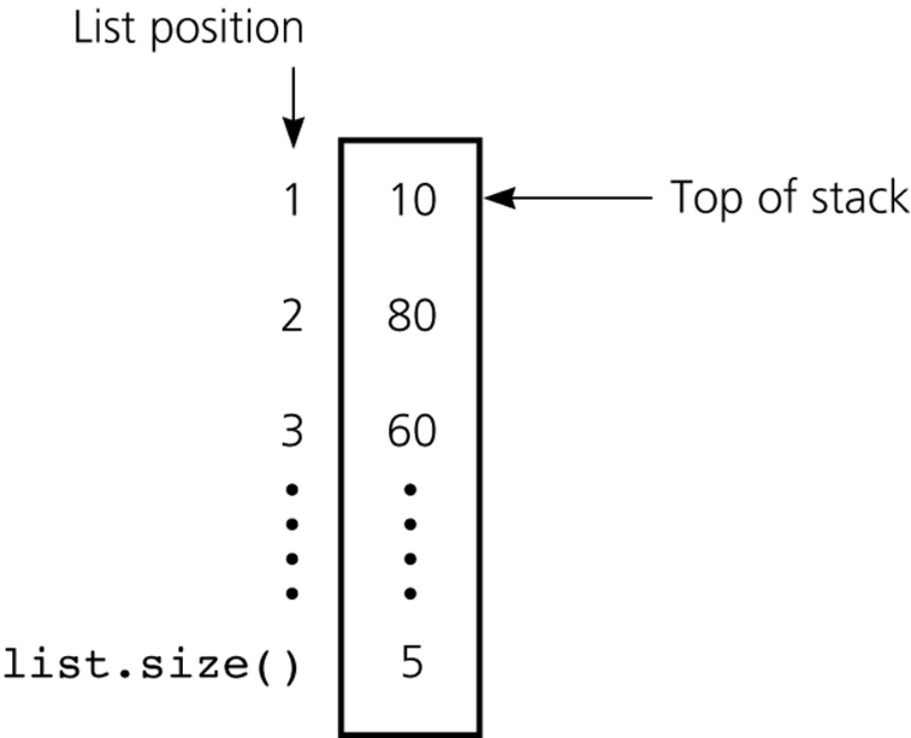
An Implementation That Uses the ADT List
Figure 7-7
An implementation that uses the ADT list

Slide 22
Please open file carrano_ppt07_B.ppt
to continue viewing chapter 7.

